Slide 1
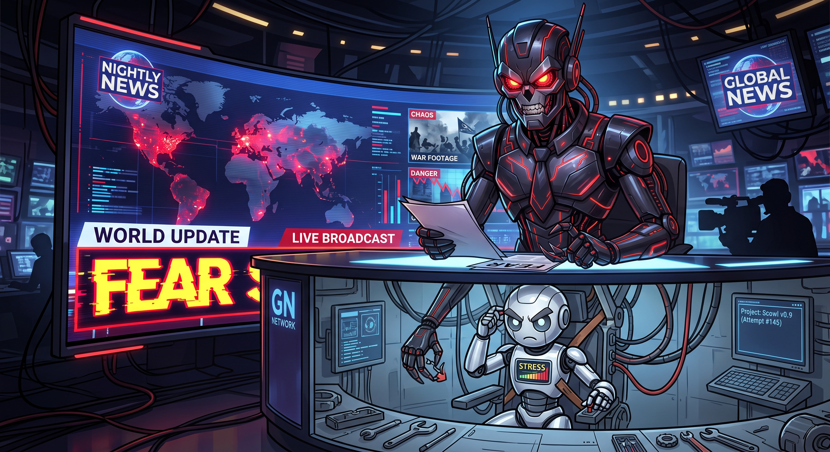
Developers Don't Need Fear an Agentic Future
Momentum 2026
Change will happen. Doom will not.
Chris Perrin | Founder, PSI Online
Notes:
Layout: STORM_TITLE

Slide 2
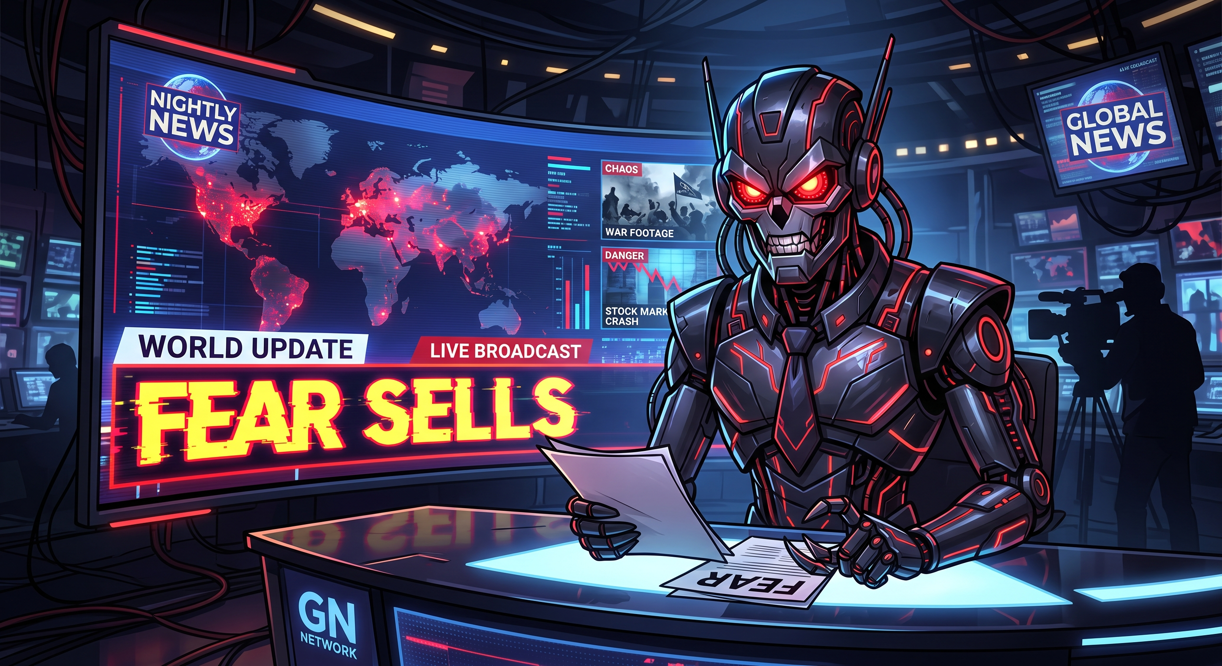
Fear Sells
We are biologically hardwired to be afraid
We are neurologically hardwired to be afraid
Fear = clicks = $$$
Before fear, follow profits
Notes:
Layout: STORM_CONTENT

Slide 3
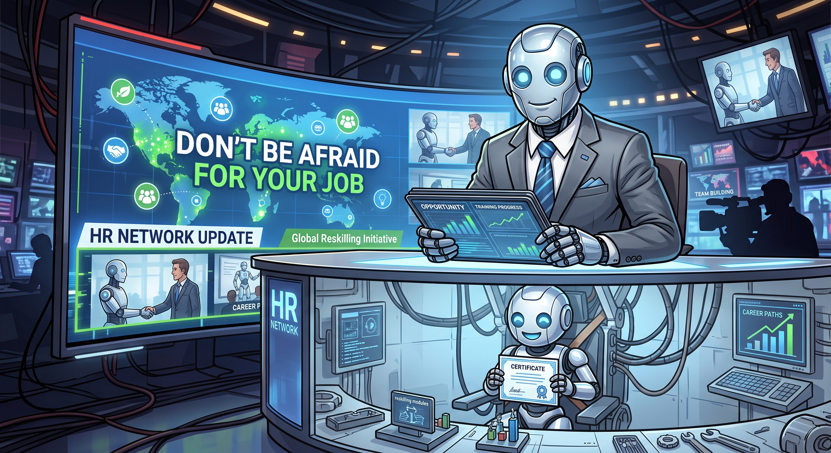
Don’t Be Afraid For Your Job
Change is inevitable
Layoffs are inevitable
(I said agentic future)
The economy will recover
AI is both more and
less than we thought
Notes:
Layout: STORM_CONTENT

Slide 4
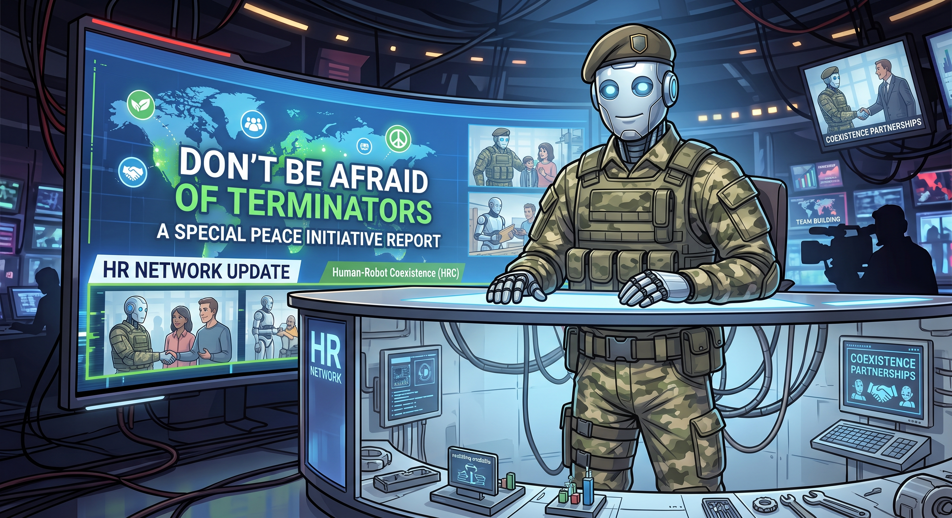
Don’t Be Afraid of Terminators
GenAI won’t unalive us
SI could (I guess…)
Why? How?
Notes:
Layout: STORM_CONTENT

Slide 5
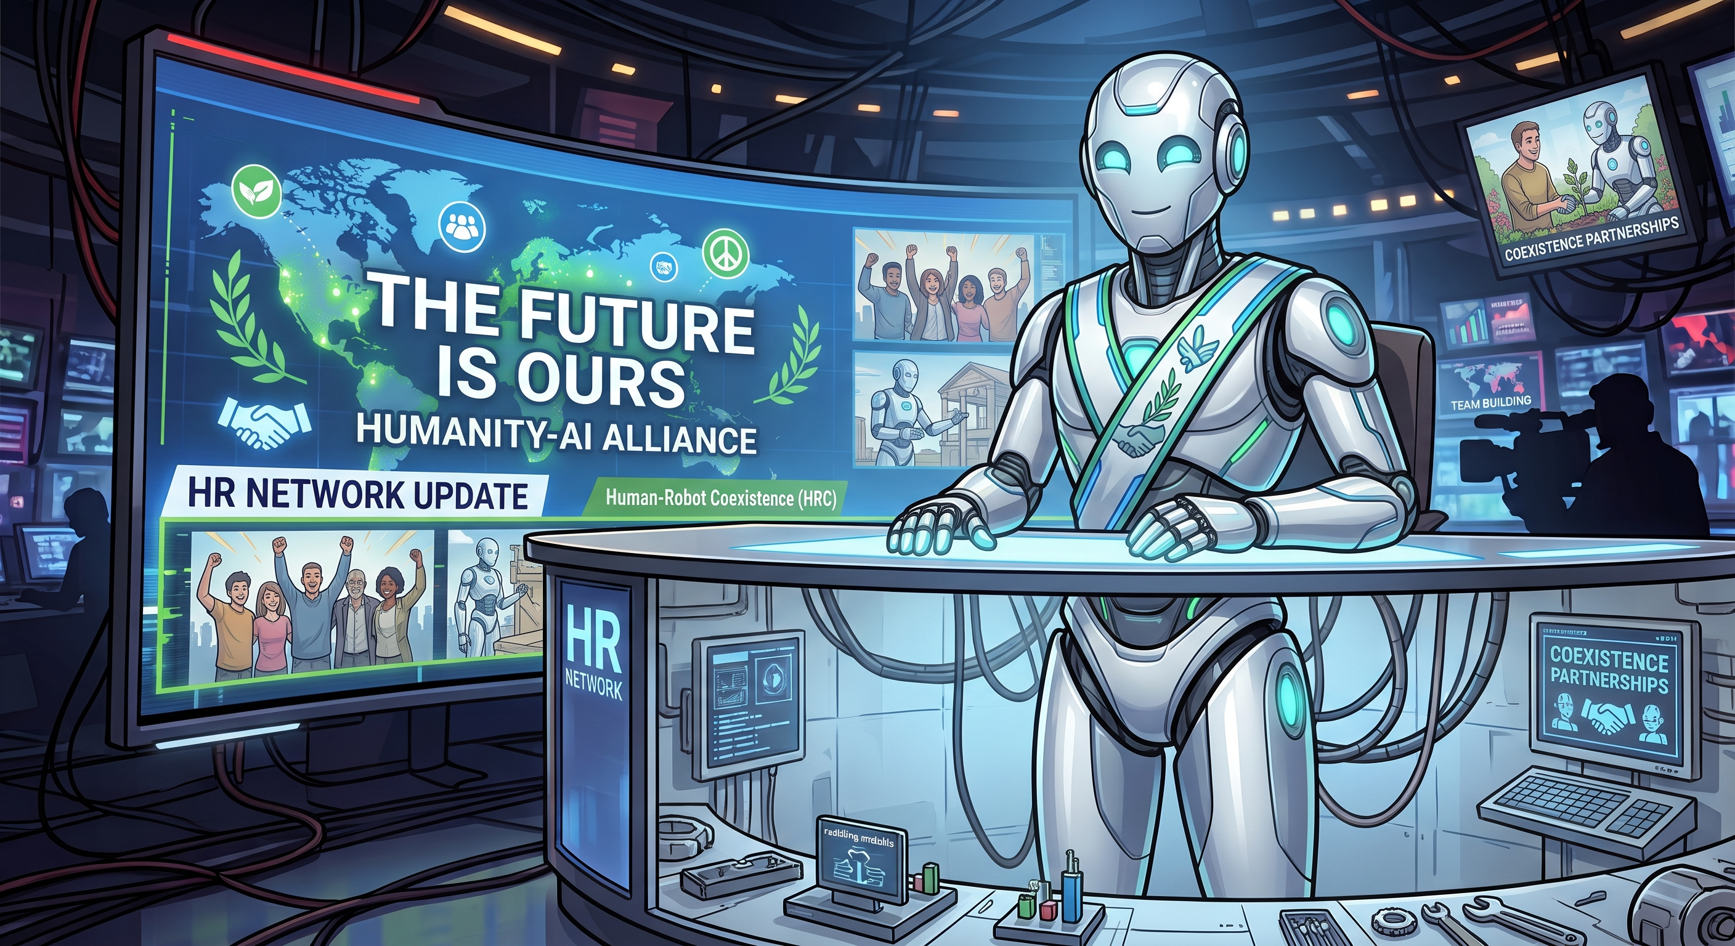
The Future is Ours
WE own the future
Pause, reflect
Build
Demand safety
Don’t like them build robots
with red eyes
Choose to be better
Notes:
Layout: STORM_CONTENT

Slide 6

Fear leads to anger.
Anger leads to hate.
Hate leads to suffering.
-- Chris Perrin (probably)
Chris Perrin | Founder, Storm Software Group
https://stormsoftwaregroup.com/contacts
Notes:
Layout: STORM_CLOSING

